Slide 1




Medical Laboratory
DB
System
Presented BY :
Malak Ashraf Ghoneim
241001356
241000534
Habiba Ahmed Fareed
Malak Ali Allam
241001107
Saria Mohamed
241002118
Database and Data Analysis

Slide 2
Project Overview
Goal
Design and implement a relational database for a Medical Laboratory System that tracks laboratorians, patients, medical tests, test results, and lab components (materials).

Slide 3
ENTITIES & ATTRIBUTES
Laboratorian
Patient
Component
Medical Test
Test Result
Laboratorian_ID
Name
Lab_Phone
Lab_Address (Street, City, Apt)
Patient_ID
Patient_Name
Patient_Phone
Patient_Address
Job
Birth_Date
Age (Derived)
Component ID
Name_of components
Available_ Quantity
Minimum_Quantity
Test_ID
Name_Of _Medical_Test
Price
Related_
Components
Test_Result_ID
Result
TS_Date

Slide 4
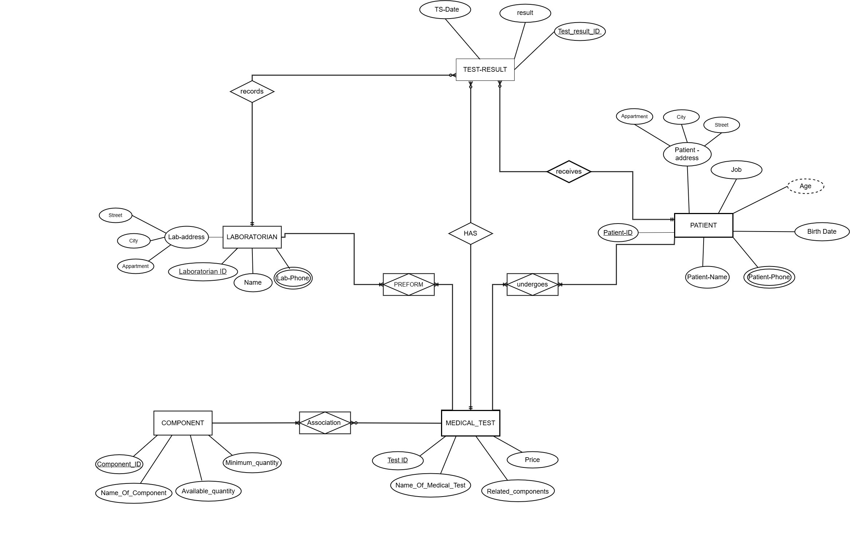
Conceptual Design – ER Diagram
Fig 1 – Entity-Relationship Diagram (Conceptual Model)

Slide 5
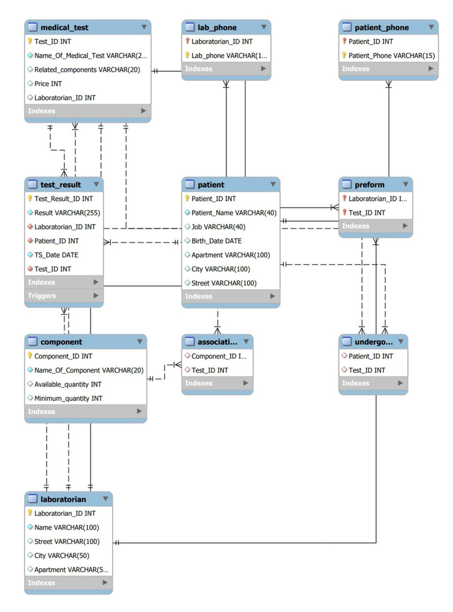
Physical EER Model
Fig 2– Physical ERD (MySQL Workbench)

Slide 6
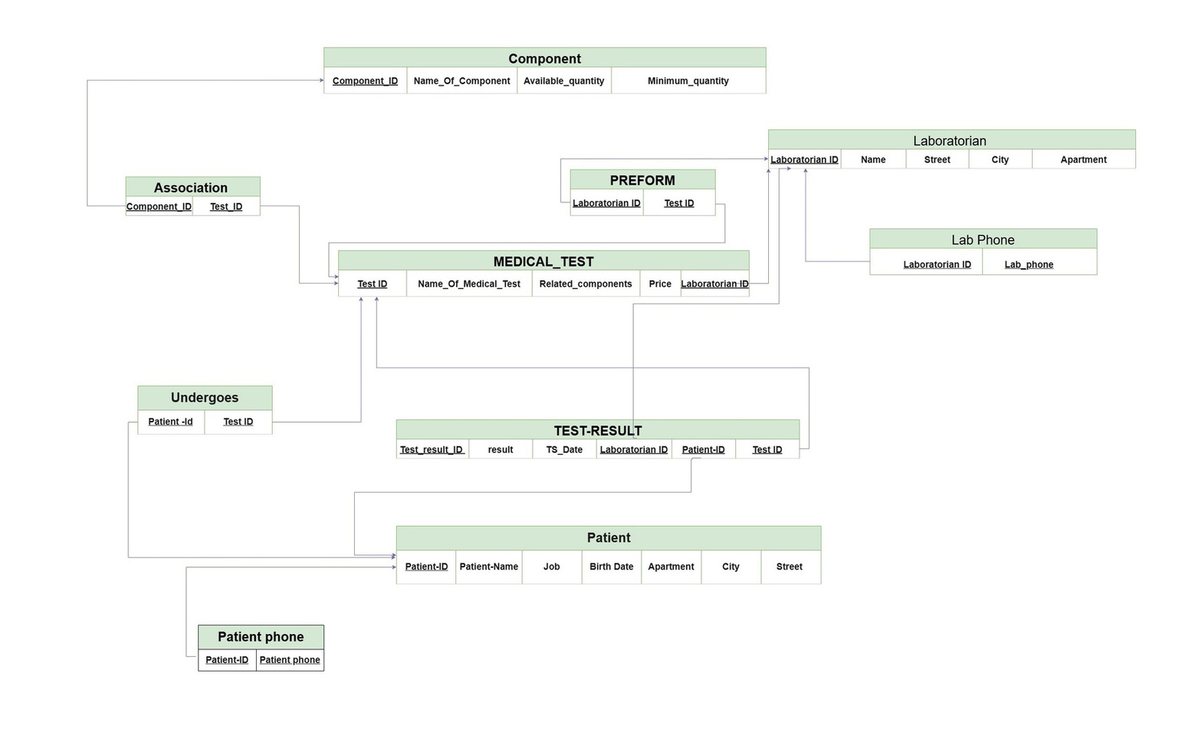
Relational Schema – Table Map
Fig 3 – Mapping

Slide 7

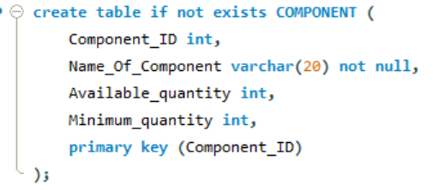
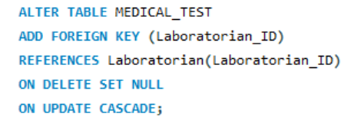
DDL – Data Definition Language
DDL (Data Definition Language) is the set of SQL commands used to define and build the structure of the database — the tables, columns, data types, and relationships. It does not touch the data itself.
CREATE DataBase
CREATE TABLE
ALTER TABLE
Creates a new database and defines its name, character set, collation, and ownership settings.
Builds a new table and defines its columns, data types, and constraints (PK, FK, NOT NULL).
Adds or modifies a table after it was created. We used it to add Foreign Keys that couldn't be added earlier due to circular dependencies.

Slide 8
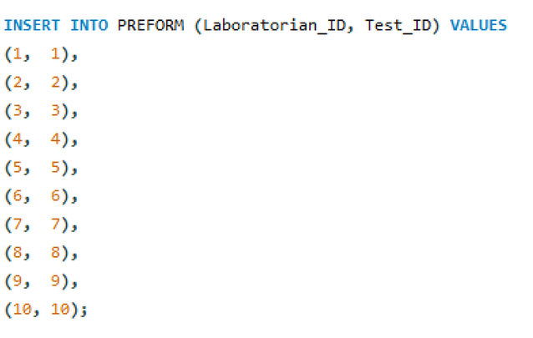
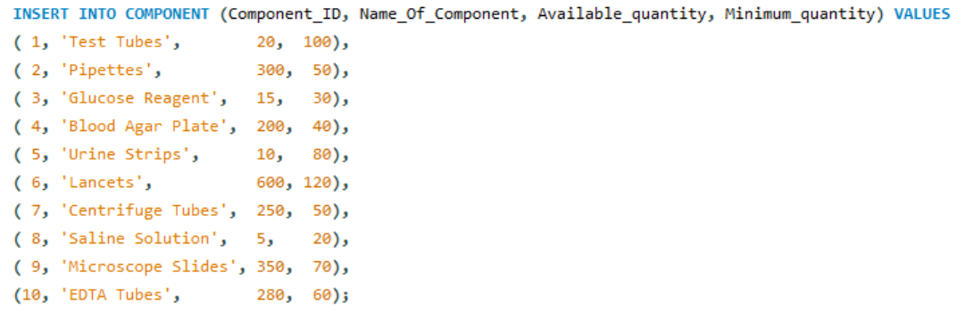
DML – Data Manipulation Language
What it is, what commands we used, and why
DML (Data Manipulation Language) is the set of SQL commands used to work with the data inside the tables — inserting, updating, deleting, or reading records. This is what fills the database with real information.
INSERT INTO
Adds new rows of data into a table. We used this to populate all 10 tables with sample data.

Slide 9
DDL vs DML – Summary
 | DDL – Data Definition Language | DML – Data Manipulation Language
Purpose | Defines the structure of the database | Works with the data inside the database
Analogy | Building the rooms in a house | Moving furniture into the rooms
Commands used | CREATE TABLE, ALTER TABLE, CREATE INDEX | INSERT INTO, SELECT, UPDATE (in trigger)
When run | Once, at the start — to set up tables | Every time data needs to be added/read/changed
Our project | Created 10 tables with all PKs, FKs, constraints | Inserted 80+ rows across all tables; 3 SELECT queries
Affects schema? | Yes — changes the table structure | No — only affects the data inside

Slide 10
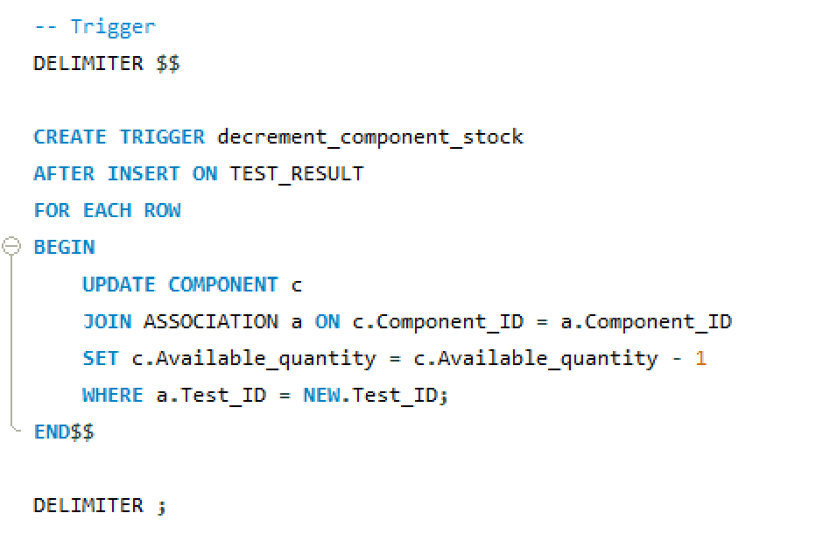
Q1 – Trigger: Decrement Component Stock
A new TestResult should decrement component stock. How would you implement that in a trigger?
Answer
Timing:
AFTER INSERT on TEST_RESULT — fires once per new result row.
Action:
JOIN ASSOCIATION on Test_ID, then UPDATE COMPONENT.Available_quantity = Available_quantity − 1 for every component linked to that test.
Why AFTER?
Ensures the row is committed first; referential integrity is already guaranteed.

Slide 11
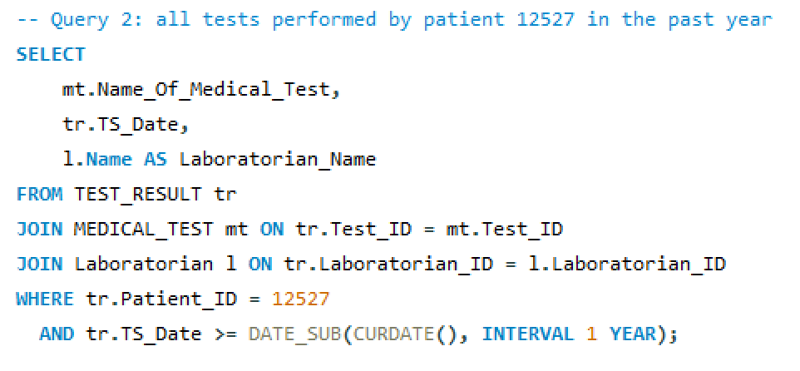
Q2 – Query: Patient 12527 Tests in the Past Year
Write in words a query to list all tests performed by patient 12527 in the past year, including test date and laboratorian.
From the TEST_RESULT table, retrieve the test name, test date, and laboratorian name by joining with MEDICAL_TEST (to get the test name) and Laboratorian (to get the name). Filter rows to Patient_ID = 12527 and TS_Date within the last 12 months using DATE_SUB(CURDATE(), INTERVAL 1 YEAR).
Answer
Expected output: Test name | Date | Laboratorian Name — one row per test undergone by this patient in the past 12 months.

Slide 12
Sample Data & Query Results
Low-Stock Alert Results (Available < Minimum)
Component ID | Name | Available | Minimum
1 | Test Tubes | 20 | 100
3 | Glucose Reagent | 15 | 30
5 | Urine Strips | 10 | 80
8 | Saline Solution | 5 | 20
Trigger Effect
After each INSERT into TEST_RESULT, the trigger auto-decrements Available_quantity for every component linked to that test via the ASSOCIATION table.
13 test results inserted → 20 component decrements applied automatically.
Q2 Result – Tests by Patient 12527
Test Name | Date | Laboratorian
Blood Glucose | 2025-06-10 | James Anderson

Slide 13
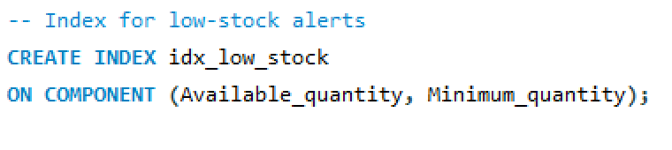
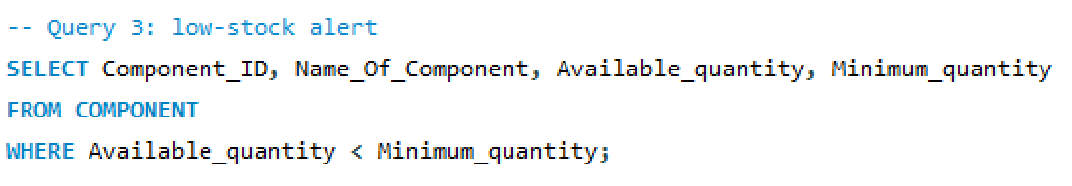
Q3 – Index for Low-Stock Alerts
Which index(es) speed up low-stock alerts (components below minimum_quantity)?
Answer & Reasoning
The alert query is:
WHERE Available_quantity < Minimum_quantity
A composite index on (Available_quantity, Minimum_quantity) lets the database engine evaluate this condition entirely within the index — without reading the main table rows (index-only scan).
Why composite?
Both columns appear in the filter expression. A single-column index on Available_quantity alone would still require a table lookup to fetch Minimum_quantity for comparison.
Result: Significantly faster scans on large component inventories.

Slide 14
Application / UI Overview
Python + Tkinter desktop app connecting to the MySQL project database via mysql.connector
Tech Stack
Module Structure (9 files)
Language: Python 3
GUI Toolkit: Tkinter
DB Driver: mysql.connector
Database: MySQL (PROJECT)
Architecture: 9 modules, single responsibility
db.py — DB connection factory
styles.py — Shared colours & widgets
main.py — Dashboard & entry point
patients.py — Patients CRUD
laboratorians.py — Staff CRUD
components.py — Inventory window
tests.py — Medical test catalogue
results.py — Test results CRUD
reports.py — Analytical queries

Slide 15
Dashboard & Style Pages
Dashboard (main.py)
Entry point — maximised Tk window with a 2×3 tile grid. Each tile (Patients, Laboratorians, Components, Medical Tests, Test Results, Reports) opens the matching module window. Hover effects highlight tiles on mouse-over without any extra library.
styles.py — Visual Consistency
Colour palette (7 constants)
NAVY #1b2a4a (headers), BLUE #3d5a99 (buttons), ACCENT #5b8dee (highlights), WHITE / BG / SUBTEXT
5 reusable builder functions:
apply_treeview_style() Sets ttk theme, row colours, heading style
page_header() Dark navy banner with icon + title
make_form() 2-column label/entry grid in white card
make_buttons() Horizontal styled button row
make_tree() ttk.Treeview + vertical scrollbar
Changing a colour or font in styles.py propagates to all pages automatically.

Slide 16
CRUD Pages — Shared Pattern
Page Structure
3 Operations
Notable Differences
1. Toplevel window (dashboard stays open)
2. page_header() renders banner
3. make_form() builds input fields
4. make_tree() builds data table
5. load() / add() / delete() functions
6. make_buttons() wires Add / Delete / Refresh
load()
Clears tree, runs SELECT, inserts rows with alternating colours
add()
Validates fields, runs INSERT, commits, refreshes
delete()
Reads PK from selected row, runs DELETE, refreshes
patients / laboratorians.py
Phone in separate child table; DELETE removes phone first (FK constraint)
components.py
Rows where Available < Minimum highlighted red
results.py
SELECT shows all FK IDs (Lab, Patient, Test) in one view

Slide 17
Shared Styles & Reports Module
reports.py — Analytical Queries
Design pattern
Single ttk.Treeview with a generic Result column. Each query button calls run(fn) which dynamically rebuilds column headings from the query result tuple.
Query 1 — Tests by Patient 12527
3-table JOIN (TEST_RESULT + MEDICAL_TEST + Laboratorian), filtered to Patient_ID=12527 and TS_Date within last 12 months. Returns: Test Name | Date | Laboratorian.
Query 2 — Low-Stock Alert
SELECT from COMPONENT WHERE Available_quantity < Minimum_quantity. Shows Component ID | Name | Available | Minimum for immediate restocking decisions.
Extensible: adding a new query only requires one data function + one button entry.

Slide 18
Summary & Conclusion
1
Conceptual Design
Full ER diagram with 8 entities, composite keys, and multivalued attributes correctly modeled.
2
Relational Schema
All tables normalized; foreign keys with appropriate ON DELETE / ON UPDATE rules.
3
Trigger
AFTER INSERT trigger auto-decrements component stock via ASSOCIATION join.
4
Query (Q2)
3-table JOIN with date filter retrieves patient history including laboratorian info.
5
Index (Q3)
Composite index on (Available_quantity, Minimum_quantity) enables fast low-stock scans.
6
Application / UI
Python + Tkinter desktop app with full CRUD and analytical reports.
Medical Laboratory System • Project 4 • Database Systems

Slide 19
THANK YOU
Medical Laboratory System • Project 4 • Database Systems

